Slide 1

University of Chittagong
Nested Loops
Dr. Abu Nowshed Chy
Department of Computer Science and Engineering
Faculty Profile

Slide 2
Nested “For” Loop
Condition:
Nested loops consist of an outer loop with one or more inner loops.
Outer loop
for(initialization; test condition; increment)
{
for (initialization; test condition; increment)
{
body of the loop
}
}
Inner loop
General Form
2

Slide 3
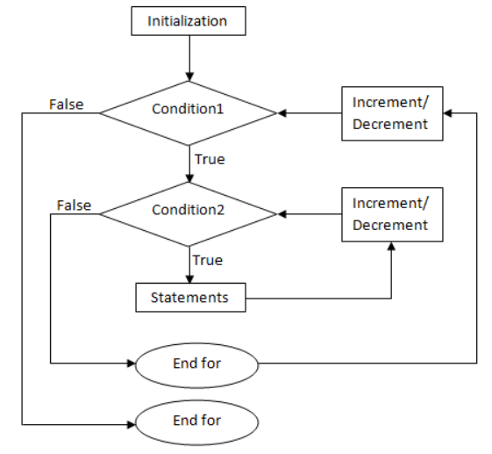
Nested “For” Loop
Flow Chart
3

Slide 4
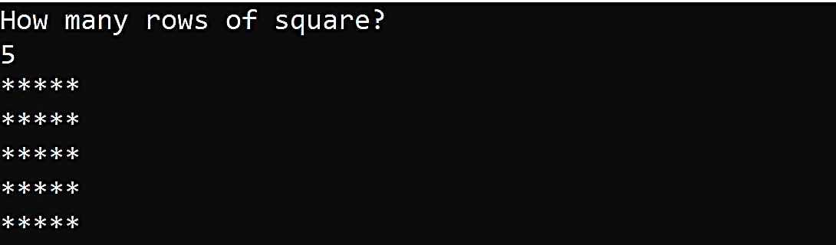
Display Star Square
Output:
4

Slide 5
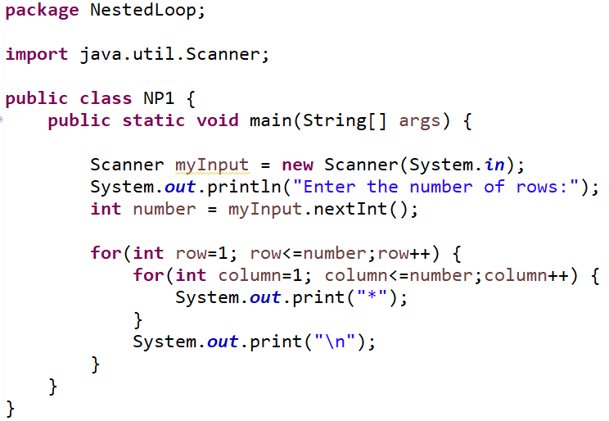
Display Star Square
5

Slide 6
Display Star Square Flowchart
row=1
no
row<=n
row++
yes
no
col<=n
col++
yes
print “*”
End of for
print “\n”
End of for
6

Slide 7
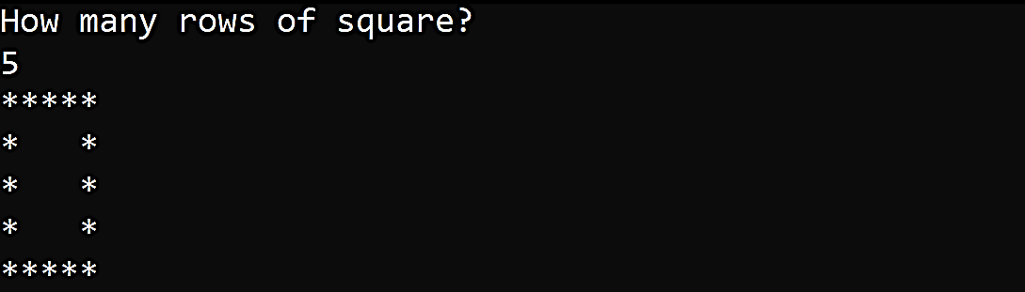
Display Star Square Boundary
Output:
7

Slide 8
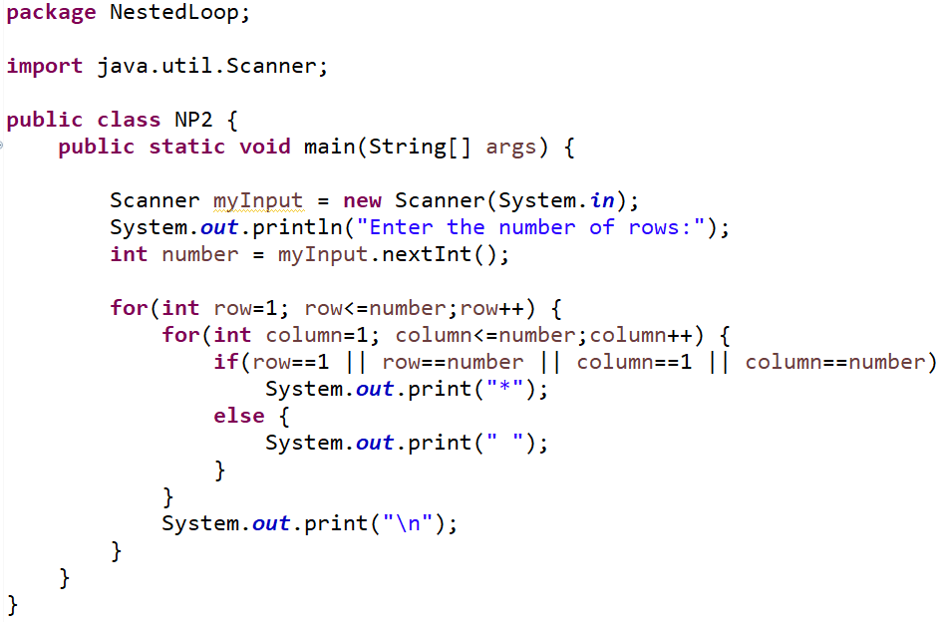
Display Star Square Boundary
8

Slide 9
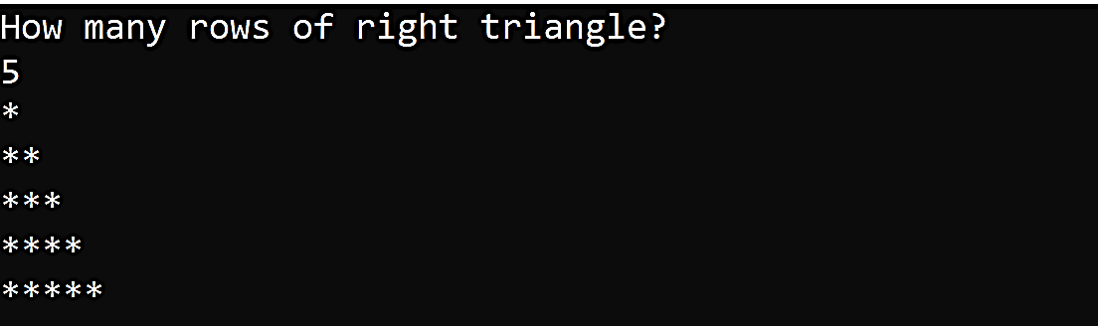
Display Right Triangle
Output:
9

Slide 10
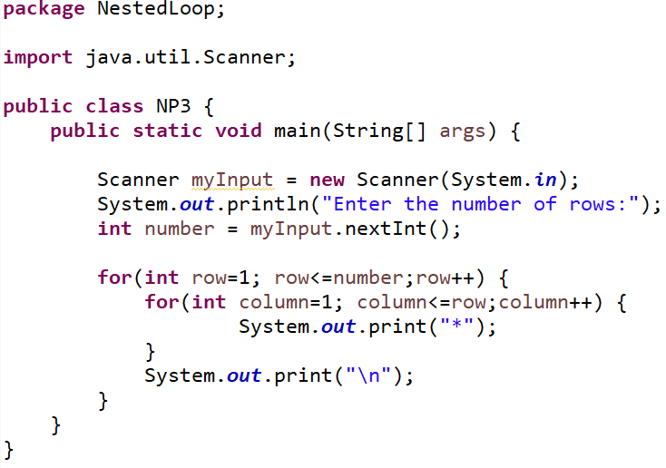
Display Right Triangle
10

Slide 11
Display Right Triangle Flowchart
row=1
row<=n
no
row++
yes
no
col<=row
col++
yes
print “*”
End of for
print “\n”
End of for
11

Slide 12
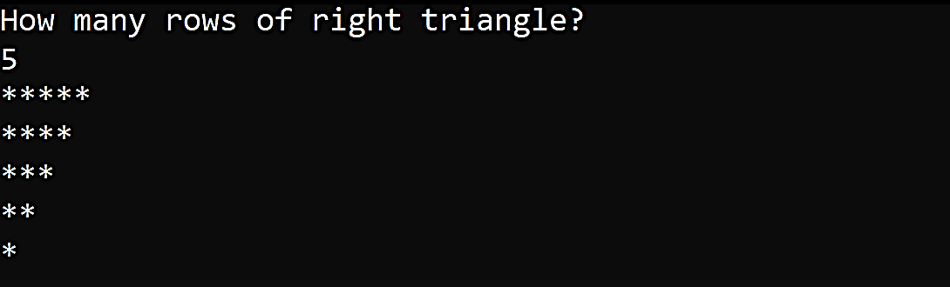
Display Inverted Right Triangle
Output:
12

Slide 13
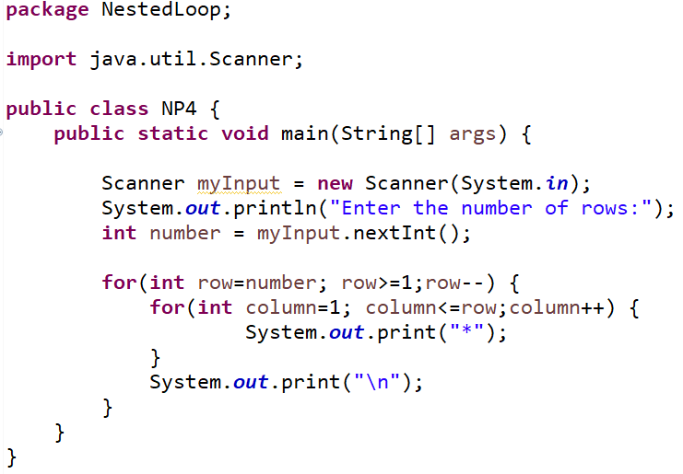
Display Inverted Right Triangle
13

Slide 14
Display Inverted Right Triangle Flowchart
row=n
row>=1
no
row--
yes
no
col<=row
col++
yes
print “*”
End of for
print “\n”
End of for
14

Slide 15
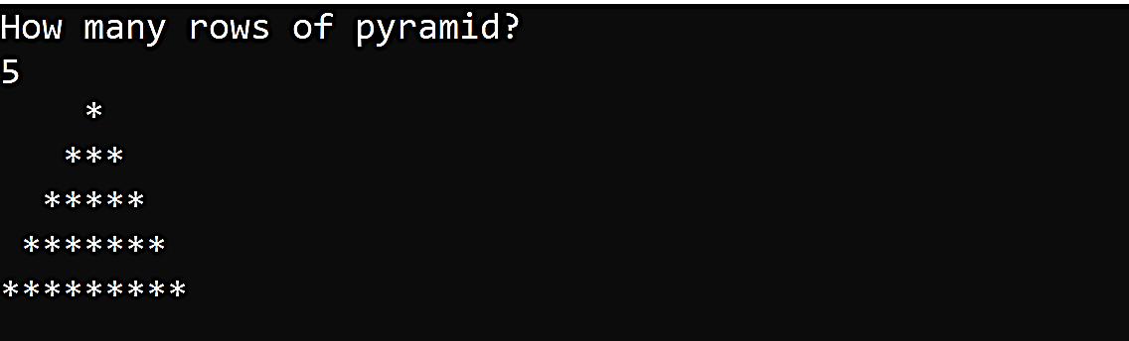
Display Star Pyramid
Output:
15

Slide 16
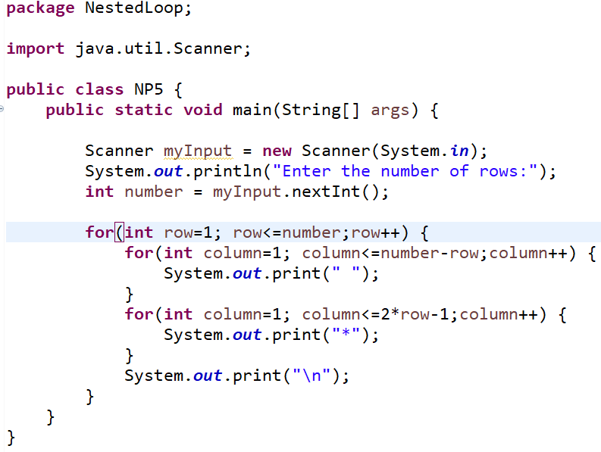

Display Star Pyramid
16

Slide 17
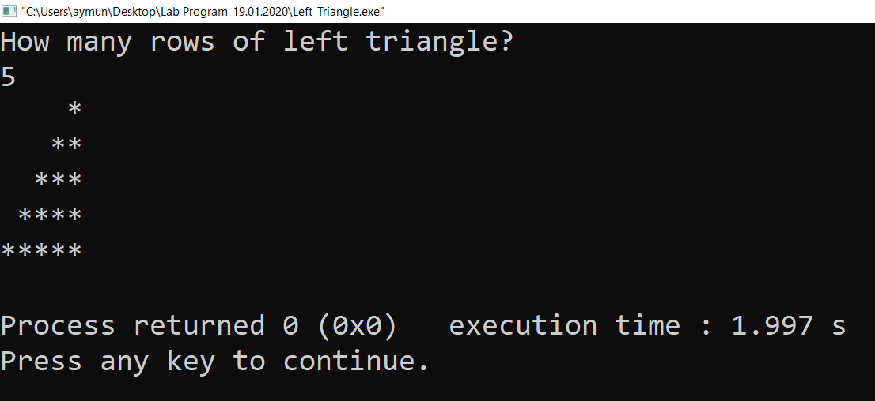
Practice Task (Nested Loops)
Program: Display left triangle
Output:
17

Slide 18
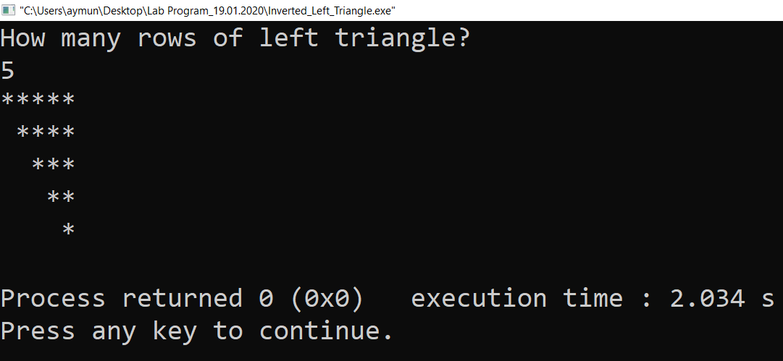
Practice Task (Nested Loops)
Program: Display inverted left triangle
Output:
18

Slide 19
Practice Task (Nested Loops)
https://overiq.com/c-examples/c-program-to-print-various-triangular-patterns/
https://www.programiz.com/c-programming/examples/pyramid-pattern
19

Slide 20

20

